Slide 1


TY PROGRAMMING
INTRODUCTION TO PYTHON

Slide 2

WHAT IS PYTHON USED FOR?
WEB DEVELOPMENT
- GOOGLE, YOUTUBE, SPOTIFY.
ARTIFICIAL INTELLIGENCE
- HEAR: DETECTING GUNSHOTS AND NOTIFYING AUTHORITIES.
- SMELL: DETECT ILLNESS BY SMELLING YOUR BREATH.
- SEE: MACHINE VISION (SELF DRIVING CARS).
- WRITE: THE NEW YORK TIMES USES AI TO HELP THEM WRITE ARTICLES.
SCRIPTING
- A SCRIPT IS A SMALL PROGRAM THAT AUTOMATES A TASK FOR YOU, FOR EXAMPLE YOU COULD USE PYTHON TO WRITE A SCRIPT THAT ORGANISES YOUR COMPUTER FOLDERS!

Slide 3

LESSON 01
PRINTING TO THE SCREEN

Slide 4
PRINTING TO THE SCREEN
WHAT YOU WILL NEED TO KNOW A LITTLE BIT ABOUT:
-CHARACTERS
-STRINGS
-FUNCTIONS
AT THE END OF THIS LESSON, YOU WILL WRITE YOUR OWN PYTHON PROGRAM.
DON’T WORRY ABOUT THE JARGON, THIS IS WAY EASIER THAN IT SOUNDS.

Slide 5
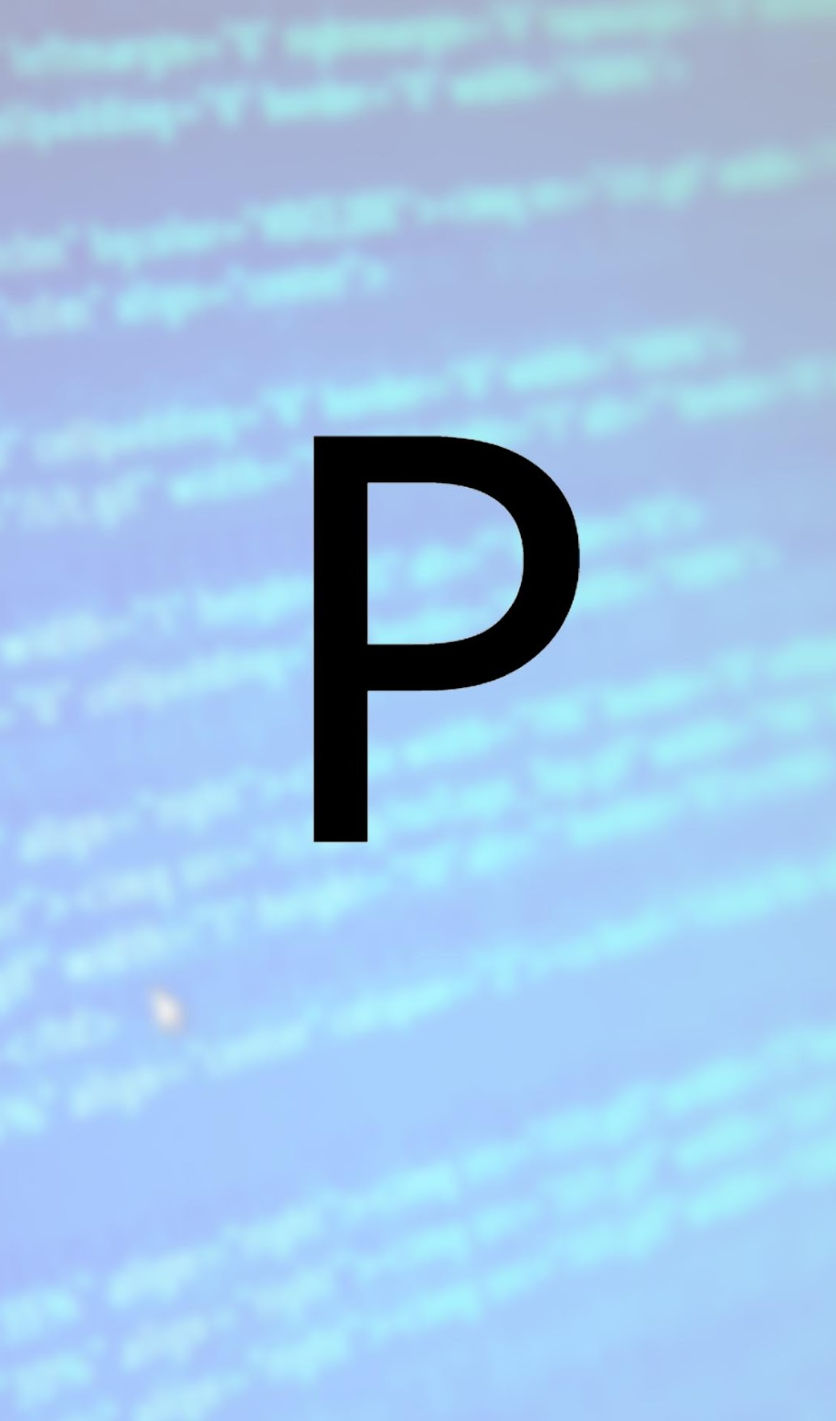
PRINTING TO THE SCREEN
CHARACTERS
A CHARACTER IS ESSENTIALLY ANY SINGLE THING YOU CAN OUTPUT TO THE SCREEN USING YOUR KEYBOARD
WHEN WE NEED TO CREATE A CHARACTER WHILE PROGRAMMING, WE MUST SURROUND IT BY QUOTATION MARKS “ ”
SO FOR EXAMPLE THE FIRST CHARACTER IN THE WORD PYTHON IS “P”.
THINK OF A CHARACTER LIKE ANY SINGLE LETTER, DIGIT OR SYMBOL.

Slide 6

PRINTING TO THE SCREEN
STRINGS
STRINGS IN PYTHON ARE GROUPS OF 2 OR MORE CHARACTERS.
JUST LIKE WITH A CHARACTER, WHEN WE WANT TO CREATE A STRING, WE MUST SURROUND IT BY QUOTATION MARKS “ ”
SO THE ONE STRING:
“PYTHON”
IS MADE UP OF THE SIX INDIVIDUAL CHARACTERS:
“P” “Y” “T” “H” “O” “N”

Slide 7
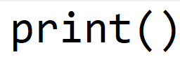
PRINTING TO THE SCREEN
FUNCTIONS
A FUNCTION IS A REUSABLE PIECE OF CODE THAT DOES A TASK FOR US SUCH AS PRINTING TO THE SCREEN.
TO CREATE THE PRINT FUNCTION, ALL YOU HAVE TO DO IS TYPE THE WORD PRINT WITH A PAIR OF BRACKETS AT THE END.
THE BRACKETS LET US KNOW THAT THIS PIECE OF CODE IS A FUNCTION.

Slide 8
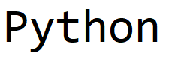
PRINTING TO THE SCREEN
RECALL
CHARACTERS AND STRINGS MUST BE SURROUNDED BY “QUOTATION MARKS”.
TO PRINT THE STRING “PYTHON”
ALL WE DO IS TYPE THE PRINT FUNCTION LIKE SO: PRINT()
AND THEN PUT THE STRING WE WANT TO PRINT INSIDE OF THE BRACKETS.
EXAMPLE: PRINT(“PYTHON”)
THIS WILL GIVE US THE OUTPUT:
COMPLETE EXERCISE 01

Slide 9
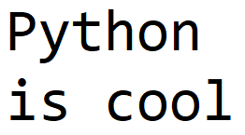
THE NEW LINE SPECIAL CHARACTER
CREATING A NEW LINE WITHIN A PRINT FUNCTION
IF WE WANT TO USE A SINGLE PRINT FUNCTION TO PRINT SOMETHING ON TWO OR MORE LINES, WE CAN USE THE SPECIAL NEWLINE CHARACTER WHICH LOOKS LIKE THIS: \N
PRINT("PYTHON\NIS COOL")
WILL GIVE YOU THE OUTPUT:

Slide 10
CREATING A NEW LINE
CREATING A NEW LINE
IF WE WANT TO USE MULTIPLE PRINT FUNCTIONS TO PRINT SOMETHING ON TWO OR MORE LINES, WE CAN JUST USE TWO OR MORE PRINT FUNCTIONS, WHICH LOOKS LIKE THIS:
PRINT("PYTHON")
PRINT("IS COOL")
WILL GIVE YOU THE OUTPUT:

Slide 11
THE NEW LINE SPECIAL CHARACTER
THE PRINT FUNCTION AND NEW LINES
THE PRINT FUNCTION COMES WITH AN INBUILT NEWLINE CHARACTER AT THE END.
YOU COULD THINK OF IT LIKE THIS: PRINT()\N
WITH THE \N BEING HIDDEN!
THEREFORE EACH NEW PRINT FUNCTION PRINTS ONTO A NEW LINE

Slide 12
THE NEW LINE SPECIAL CHARACTER
YOU CAN CHANGE THIS!
YOU CAN SPECIFY THAT YOU WANT TO CHANGE WHAT COMES AT THE END OF THE PRINT() FUNCTION.
WE CAN DO THIS LIKE SO:
PRINT("PYTHON", END=" ")
PRINT("IS COOL")
THIS WILL GIVE US THE OUTPUT "PYTHON IS COOL" BECAUSE WE HAVE CHANGED THE \N NEWLINE CHARACTER AT THE END OF THE PRINT FUNCTION TO A SPACE CHARACTER " ".

Slide 13

PRINTING TO THE SCREEN
USING THE TAB
IF WE WANT TO TAB IN A LITTLE BIT TO GIVE US SOME SPACE OR FORMAT SOME TEXT A CERTAIN WAY, WE CAN USE THE SPECIAL TAB CHARACTER WHICH LOOKS LIKE THIS: \T
PRINT(“*\TPYTHON IS COOL\T*")
WILL GIVE THE OUTPUT:

Slide 14
SUMMARY
TODAY YOU LEARNED ABOUT:
CHARACTERS.
STRINGS.
FUNCTIONS.
HOW TO USE FUNCTIONS TO PRINT STRINGS.
SOME SPECIAL CHARACTERS TO USE WHEN PRINTING STRINGS.

Slide 15
LESSON 02
VARIABLES & DATA TYPES

Slide 16

LESSON 1 RECAP
IN THE FIRST LESSON WE LEARNED ABOUT:
CHARACTERS: WHICH ARE ANY SINGLE THING WE CAN OUTPUT USING OUR KEYBOARD.
STRINGS: WHICH ARE GROUPS OF 2 OR MORE CHARACTERS.
QUOTATION MARKS: THAT CHARACTERS AND STRINGS NEED TO BE SURROUNDED BY QUOTATION MARKS.
FUNCTIONS: WHICH ARE REUSABLE PIECES OF CODE THAT DO A TASK FOR US.
HOW TO USE THE PRINT FUNCTION TO OUTPUT TO OUR SCREENS: PRINT()

Slide 17
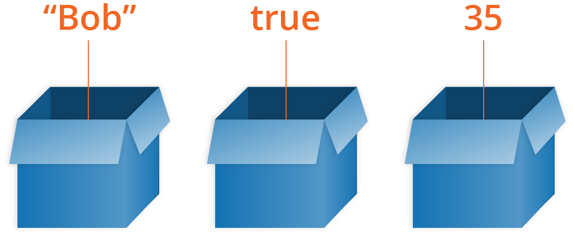
PART 1 - VARIABLES

Slide 18
VARIABLES
Data type | Short-hand name | Description of data type | Example of data type
Integer number | int | An int is a whole number | 10
Floating point number | float | A float is a decimal number | 3.14
Character | char | A single keyboard digit | "A"
String | str | A sentence or collection of characters | "My favourite food is pizza"
Boolean | bool | Holds the value of either True or False | True
WHAT IS A VARIABLE?
A VARIABLE IS A CONTAINER THAT WE CAN CREATE IN OUR PROGRAM TO STORE A VALUE.
WHAT VALUES CAN A VARIABLE STORE?
IN PYTHON, THERE ARE DIFFERENT TYPES OF VALUES WHICH WE CALL DATA TYPES.
A VARIABLE CAN BE USED TO STORE ANY OF THESE DATA TYPES.

Slide 19
VARIABLES
CREATING A VARIABLE
TO CREATE A VARIABLE, WE TYPE (OR "DECLARE") THE NAME OF THE VARIABLE, AND THEN WE ASSIGN A VALUE TO THE VARIABLE.
IN PYTHON, THE ASSIGNMENT OPERATOR IS "=" WHICH YOU KNOW AS THE EQUALS SIGN.
LET'S SUPPOSE WE WANT TO CREATE ONE VARIABLE TO STORE A STRING WITH OUR FAVOURITE ANIMAL IN IT AND ANOTHER VARIABLE TO STORE OUR BIRTH YEAR.
WHICH IN OUR CODE EDITOR, LOOKS LIKE:
MY_FAVOURITE_ANIMAL = "HIPPOPOTAMUS"
MY_BIRTH_YEAR = 2004
Variable name | Assignment operator | value
my_favourite_animal | = | "hippopotamus"
my_birth_year | = | 2004

Slide 20
VARIABLES
RULES FOR NAMING YOUR VARIABLES
CAN CONTAIN ONLY NUMBERS, LETTERS AND UNDERSCORES.
MUST NOT START WITH A NUMBER (BUT IT MAY CONTAIN ONE).
MY_INCOME_1 IS OKAY.
1_MY_INCOME IS NOT OKAY.
NO SPACES IN THE VARIABLE NAME.
NO SPECIAL CHARACTERS (SUCH AS ‘@’).
MUST NOT BE A PYTHON KEYWORD (E.G. TRUE, NONE, FALSE, BREAK).
DON'T MAKE YOUR VARIABLE NAMES TOO LONG.
THE PYTHON NAMING CONVENTION IS TO USE ALL LOWERCASE LETTERS, JOINED BY UNDERSCORES:
E.G. MY_VARIABLE, MY_AGE, HOUSE_WIDTH, NUMBER_OF_PETS

Slide 21
VARIABLES
EXAMPLES OF VARIABLES:
NAME = "JOHN“ AGE = 15 LATEST_GRADE = "B“ GRADE_POINT_AVERAGE = 3.8 IS_A_STUDENT = TRUE
THE VARIABLE: NAME CONTAINS THE STRING VALUE: "JOHN"
THE VARIABLE: AGE CONTAINS THE INTEGER VALUE: 15
THE VARIABLE: LATEST_GRADE CONTAINS THE CHARACTER VALUE: "B"
THE VARIABLE: GRADE_POINT_AVERAGE CONTAINS THE FLOAT VALUE: 3.8
THE VARIABLE: IS_A_STUDENT CONTAINS THE BOOLEAN VALUE: TRUE
*NB* YOU WILL NOTICE THAT YOU DO NOT NEED "QUOTATION MARKS" WHEN ASSIGNING INT, FLOAT & BOOLEAN VALUES!

Slide 22
VARIABLES
VARIABLES AND THE PRINT FUNCTION
IF YOU REMEMBER FROM LAST WEEK, WE USED THE PRINT() FUNCTION TO PRINT OUT STRINGS. WE CAN ALSO USE THE PRINT() FUNCTION TO PRINT OUT VARIABLES! AND THE GOOD NEWS IS THAT IT WORKS PRETTY MUCH THE SAME WAY.
LET'S SAY WE HAVE 2 VARIABLES THAT CONTAIN OUR PETS NAME AND WHAT YEAR WE ARE IN, IN SCHOOL.
PETS_NAME = "BOB ROSS" REMEMBER WE MUST USE "QUOTATION MARKS" FOR A STRING.
SCHOOL_YEAR = 4 RECALL THERE ARE NO NEED FOR QUOTATION MARKS FOR AN INT, FLOAT OR BOOL VALUE.
SO, LET'S PRINT THESE VARIABLES USING THE PRINT FUNCTION:
PRINT(PETS_NAME) WE CAN SIMPLY PLACE THE VARIABLES
PRINT(SCHOOL_YEAR) INSIDE THE PRINT FUNCTION TO OUTPUT THEM.
WILL GIVE THE OUTPUT:
BOB ROSS
4

Slide 23
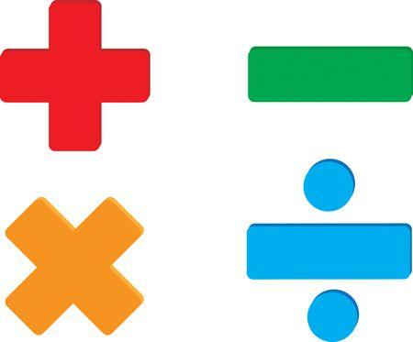
PART 2 - OPERATORS

Slide 24
OPERATORS
WHAT ARE OPERATORS?
THERE ARE DIFFERENT TYPES OF OPERATORS, WE WILL BE FOCUSING ON:
ARITHMETIC OPERATORS
ARITHMETIC OPERATORS ARE USED WITH NUMERIC VALUES TO PERFORM COMMON MATHEMATICAL OPERATIONS. ADDITION, SUBTRACTION, MULTIPLICATION ETC...
ASSIGNMENT OPERATORS
ASSIGNMENT OPERATORS ARE USED TO ASSIGN VALUES TO VARIABLES.
IN PYTHON THE "=" IS THE MAIN ASSIGNMENT OPERATOR.

Slide 25

OPERATORS
OPERATORS AND THE PRINT FUNCTION
WE CAN USE THE PRINT() FUNCTION TO PRINT OUT THE RESULTS OF MATHS PROBLEMS.
LET'S SAY WE WANTED TO KNOW WHAT 188 + 68 * 1 + 3 WAS
WE CAN USE THE PYTHON AND THE PRINT FUNCTION TO TELL US.
PRINT(188 + 68 * 1 + 3) WILL OUTPUT THE ANSWER: 259
AND WE CAN DO THIS WITH:
SUBTRACTION: PRINT(10-6) WILL OUTPUT THE ANSWER: 4
MULTIPLICATION: PRINT(5 * 4) WILL OUTPUT THE ANSWER: 20
DIVISION: PRINT(100 / 20) WILL OUTPUT THE ANSWER: 5
PYTHON FOLLOWS THE PEMDAS ORDER OF OPERATIONS. WHICH STANDS FOR:
PARENTHESES, EXPONENT, MULTIPLICATION, DIVISION, ADDITION AND SUBTRACTION.

Slide 26
ARITHMETIC OPERATORS
Operator | Name | Description | Example | In words
+ | Addition | Standard addition | 1 + 7 = 8 | One plus seven is eight
- | Subtraction | Standard subtraction | 5 – 3 = 2 | Five minus three is two
* | Multiplication | Standard multiplication | 6 * 4 = 24 | Six times four is twentyfour
/ | Division | Standard division | 18 / 6 = 3 | Eighteen divided by six is three
% | Modulus | Like standard division, but the answer is the remainder. | 10 % 3 = 1 | Ten divided by three, leaves a remainder of one
** | Exponentiation | Multiplies the left value to the power of the right value | 2 ** 5 = 32 | Two to the power of five is thirtytwo
// | Floor division | Like standard division, but the answer discards the remainder. | 10 // 3 = 3 | Ten floor divided by three is three and we discard the remainder of one.

Slide 27
ASSIGNMENT OPERATORS
Operator | Description | E.g. (number starts as 5) | Is the same as | Answers
= | Assigns a value to a variable | number = 5 | The variable number contains a value of 5 | number equals: 5
+= | Increment a variable by the amount specified after the = symbol | number += 7 | number = number + 7 | number now equals: 12 (number = 5 + 7)
-= | Deincrement a variable by the amount specified after the = symbol | number -= 3 | number = number - 3 | number now equals: 2 (number = 5 - 3)
*= | Multiply a variable by the amount specified after the = symbol | number *= 4 | number = number * 4 | number now equals: 20 (number = 5 * 4)
/= | Divide a variable by the amount specified after the = symbol | number /= 5 | number = number / 5 | number now equals: 1 (number = 5 / 5)
%= | Mod a variable by the amount specified after the = symbol | number %= 3 | number = number % 3 | number now equals: 2 (number = 5 % 3)
**= | Multiplies a variable to the power of the amount specified after the = symbol | number **= 4 | number = 5 ** 4 | number now equals: 625 (number = 5 ** 4)
//= | Floor divide a variable by the amount specified after the = symbol | number //= 2 | number = number // 2 | number now equals: 2 (number = 5 // 2)

Slide 28
SUMMARY
TODAY YOU LEARNED ABOUT:
VARIABLES
VARIABLES ARE CONTAINERS THAT HOLD A VALUE.
DATA TYPES, THAT CHARACTERS AND STRINGS ARE DATATYPES AND SOME NEW DATATYPES:
INTEGERS (WHOLE NUMBERS)
FLOATS (DECIMALS)
BOOLS (TRUE OR FALSE)
OPERATORS
THAT YOU CAN USE OPERATORS TO ASSIGN VALUES (E.G. THE = ASSIGNMENT OPERATOR)
THAT YOU CAN USE OPERATORS TO DO MATHS USING PYTHON (E.G. THE + ADDITION OPERATOR)
HOW TO USE THE PRINT FUNCTION WITH VARIABLES AND OPERATORS.

Slide 29
LESSON 03
TESTING CODE

Slide 30
LESSON 2 RECAP
IN THE SECOND LESSON WE LEARNED ABOUT:
VARIABLES: THAT A VARIABLE IS A CONTAINER THAN CAN HOLD A VALUE.
INTEGER NUMBERS: WHOLE NUMBERS.
FLOATING POINT NUMBERS: DECIMAL NUMBERS.
BOOLEAN VALUES: TRUE OR FALSE
ARITHMETIC OPERATORS: + - * /
ASSIGNMENT OPERATORS: = += -= *= /=
HOW TO USE THE PRINT FUNCTION WITH VARIABLES.

Slide 31

PART 1 WHY WE NEED TESTING

Slide 32
WHY WE NEED TESTING
FOR THE MOST PART, HUMANS WRITE SOFTWARE AND HUMANS MAKE MISTAKES.
EARLY AND CONTINUOUS TESTING IDENTIFIES FAULTS/DEFECTS IN A SOFTWARE SYSTEM EARLY ON, FINDING AND FIXING ISSUES EARLY ON IMPROVES THE QUALITY OF THE SOFTWARE AND SAVES TIME.
A FLAWED SOFTWARE PRODUCT CAN IMPACT A PRODUCT OR COMPANY'S REPUTATION.
WE NEED TO MAKE SURE OUR SOFTWARE IS SAFE TO USE AND PROTECTS ITS USERS FROM THREATS.
SOME PEOPLE RELY ON THE SOFTWARE IN VEHICLES, MEDICAL DEVICES AND OTHER MACHINES TO KEEP THEM SAFE, AS DEVELOPERS WE NEED TO TAKE THIS RESPONSIBILITY VERY SERIOUSLY.

Slide 33
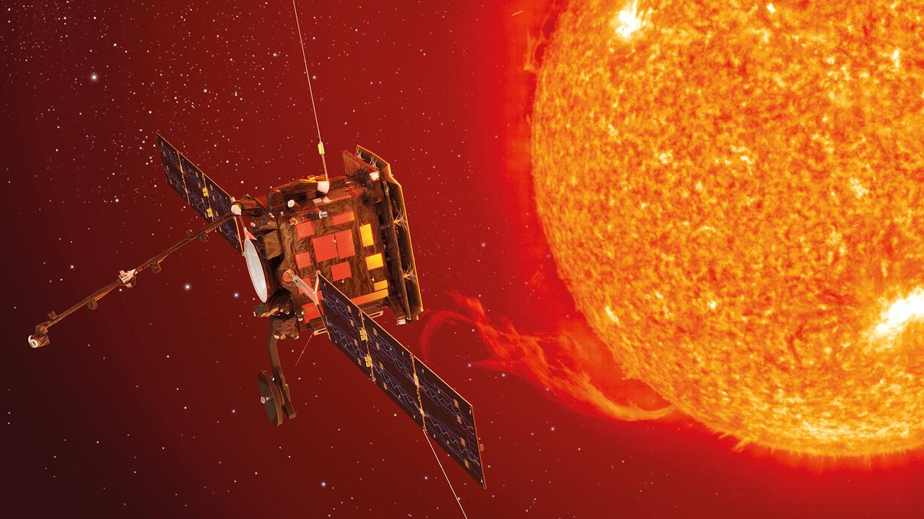
WHY WE NEED TESTING
MARS CLIMATE ORBITER
ON ITS MISSION TO MARS IN 1998, THE CLIMATE ORBITER WAS LOST IN SPACE.
IT TOOK A LONG TIME FOR ENGINEERS TO UNDERSTAND WHAT HAD HAPPENED.
A SUB-CONTRACTOR ON THE ENGINEERING TEAM HAD FAILED TO MAKE A SIMPLE CONVERSION FROM IMPERIAL UNITS TO METRIC UNITS!
THIS EMBARRASSING MISTAKE CAUSED THE $125,000,000 ORBITER TO SMASH INTO THE MARS ATMOSPHERE. THIS CRIPPLED THE COMMUNICATIONS AND SENT THE CRAFT HURTLING AROUND THE SUN.

Slide 34


WHY WE NEED TESTING
FIAT CHRYSLER
IN 2016 RECALLED OVER 1 MILLION VEHICLES.
GOVERNMENT INVESTIGATION REVEALED A
GEAR-SHIFT FLAW WHICH RESULTED IN:
266 ACCIDENTS
68 INJURIES
AT LEAST 1 DEATH (ACTOR ANTON YELCHIN)
A SOFTWARE UPDATE WAS ISSUED AFTER THE RECALL, HOWEVER THE UPDATE REPORTEDLY FAILED TO WORK FOR A FURTHER 29,000 VEHICLES.

Slide 35

WHY WE NEED TESTING
UK NATIONAL HEALTH SERVICE
ADMITTED TO MIS-PRESCRIBING MEDICATION TO 300,000 HEART PATIENTS DUE TO A SOFTWARE ERROR.
SYSTMONE, THE SOFTWARE USED TO CALCULATE THE RISK OF A HEART ATTACK, HAS REPORTEDLY PRODUCED INCORRECT RESULTS SINCE 2009.
THIS HAS LED TO PATIENTS:
SUFFERING NEEDLESSLY FROM HEART ATTACKS OR STROKES.
SUFFERING SERIOUS SIDE-EFFECTS FROM TAKING UNNECESSARY MEDICATION.

Slide 36

PART 2 TEST CASES

Slide 37
TEST CASES
A TEST CASE IS A TEMPLATE USED TO CREATE TESTS FOR SOFTWARE
A TEST CASE USUALLY CONTAINS AT LEAST:
TITLE: THE TITLE OF THE TEST CASE- KEEP IT SHORT.
DESCRIPTION: A DESCRIPTION OF THE TEST - MAKE THIS MORE DETAILED.
TEST DATA: ANY DATA THAT YOU NEED TO COMPLETE THE TEST.
TEST STEPS: CLEAR AND CONCISE INSTRUCTIONS ON HOW TO PERFORM THE TEST.
EXPECTED RESULT: THE RESULT YOU EXPECT TO OBTAIN.
ACTUAL RESULT: THE ACTUAL RESULT THAT YOU OBTAINED.

Slide 38

TEST CASES
EXAMPLE OF A TEST CASE – TEST FAILS
TITLE: CHECKING A MATHEMATICAL EXPRESSION
DESCRIPTION: USING A CERTAIN SET OF TEST DATA, CHECKING THAT THE MATHEMATICAL EXPRESSION:
188 + 68 * 1 + 3 CODE LOGIC IS CORRECT AND RETURNS THE CORRECT ANSWER.
TEST DATA – THE NUMBERS TO BE USED IN THIS TEST.
TEST STEPS:
NAVIGATE TO REPL.IT AND CREATE A PRINT() FUNCTION.
INSIDE THE PRINT FUNCTION PUT IN THE MATHEMATICAL EXPRESSION: 188 + 68 * 1 + 3
CLICK ON THE RUN BUTTON TO RUN THE PROGRAM.
RECORD YOUR RESULT.
EXPECTED RESULT: 1024
ACTUAL RESULT: 259
188 | 68 | 1 | 3

Slide 39
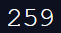
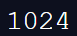
TEST CASES
DO YOU KNOW WHY THE TEST FAILED?
THERE WAS A LOGIC ERROR IN THE CODE.
EVEN THOUGH THE TEST FAILED, WE STILL CONSIDER THIS A GOOD THING.
THE TEST LET US KNOW THAT WE HAD AN ERROR IN OUR CODE.
DO YOU KNOW WHAT THE PROBLEM WAS?
Our calculation was missing some brackets!
Remember that in Python we follow the PEDMAS order of operations.

Slide 40
SUMMARY
TODAY YOU LEARNED ABOUT:
WHY TESTING IS IMPORTANT
WE NEED TO TEST TO MAKE SURE OUR CODE IS SAFE, SECURE AND WORKS AS INTENDED.
WHAT CAN HAPPEN IF WE DO NOT TEST THOROUGHLY
MALFUNCTIONING MACHINES.
INJURY.
LOSS OF TIME AND MONEY.
TEST CASES
A TEST CASE IS A TEMPLATE FOR RUNNING A TEST.
A TEST CASE DESCRIBES THE TEST, TEST STEPS AND WHAT RESULT WE THINK WE SHOULD GET.
A FAILING TEST IS NOT A BAD THING, FAILING TO TEST IS A BAD THING.

Slide 41
LESSON 04
INPUTS AND STRINGS

Slide 42
LESSON 3 RECAP
In the third lesson we learned about:
Why testing is important
Humans can make mistakes
Early fault detection
Bad software can damage a company's reputation
Software must be safe for its users
Some examples of what can go wrong if there is not enough testing done
Mars orbiter
Fiat Chrysler
UK National Health Service
Test cases

Slide 43

PART 1 INPUTS

Slide 44
TAKING USER INPUT
Up until now, we have been doing calculations using variables that have been “hard coded”.
These programs would be more dynamic, if they could take in values from a user, rather than always using values we specify before run time.
Often in programs, we will want to take an input from a user.

Slide 45




TAKING USER INPUT
Python has an input stream and an output stream.
We have already used the output stream.
print(“Hello world”)
Today we will be looking at the input stream.
input()

Slide 46

TAKING USER INPUT
WE WANT TO TAKE IN A USERS NAME, STORE IT IN A VARIABLE CALLED NAME AND THEN PRINT IT BACK TO THEM.
HOW DO WE DO THIS?
NAME = INPUT()
PRINT(“HELLO”, NAME)
DO YOU REMEMBER WHAT THE BRACKETS AT THE END OF INPUT MEAN?
IT MEANS THAT INPUT() IS A FUNCTION OR REUSABLE PIECE OF CODE THAT DOES A TASK FOR US.
THE INPUT FUNCTION IS USED TO TAKE INPUT FROM THE USER.

Slide 47
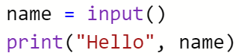

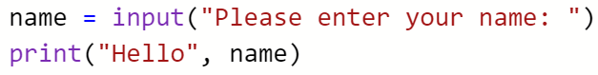
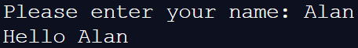
TAKING USER INPUT
THERE IS A PROBLEM WITH: NAME = INPUT()
WE HAVE NOT TOLD THE USER WHAT TO DO, THE SCREEN IS BLANK.
CODE OUTPUT
GENERALLY YOU MUST “PROMPT THE USER”
CODE OUTPUT

Slide 48

TAKING USER INPUT
WE HAVE TAKEN IN A STRING FROM THE USER.
THE INPUT FUNCTION BY DEFAULT, TAKES IN A STRING.
WHAT IF WE WANT TO TAKE IN A NUMBER? SUCH AS AN AGE.
WE NEED TO USE THE INTEGER FUNCTION TO CONVERT THE USER INPUT FROM A STRING TO AN INTEGER NUMBER.
DON’T WORRY, IT IS NOT THAT MUCH DIFFERENT THAT TAKING IN A NORMAL USER INPUT.
WE “WRAP” THE INPUT FUNCTION IN THE INTEGER FUNCTION LIKE SO:
AGE = INPUT(“PLEASE ENTER YOUR AGE: ”) BECOMES:
AGE = INT(INPUT(“PLEASE ENTER YOUR AGE: ”))
NOW, THE VARIABLE AGE IS AN INTEGER VARIABLE.
AND WE CAN DO THIS WITH DECIMAL NUMBERS TOO, USING THE FLOAT FUNCTION: FLOAT()

Slide 49
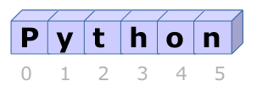
PART 2 STRINGS

Slide 50
STRINGS
STRINGS IN PYTHON ARE “IMMUTABLE”
ALL THIS MEANS IS THAT THEY CANNOT CHANGE.
THERE ARE MANY OPERATIONS AND FUNCTIONS THAT CAN BE USED WITH STRINGS.
WE CAN ADD STRINGS TOGETHER:
STRING1 = “HELLO”
STRING2 = “WORLD”
STRING3 = STRING1 + “ ” + STRING2
PRINT(STRING3)
OUTPUT:
HELLO WORLD
We can multiply strings
STRING1 = “HELLO”
STRING2 = STRING1 * 3
PRINT(STRING2)
Output:
HelloHelloHello

Slide 51
STRINGS WE CAN USE FUNCTIONS ON STRINGS, FOR EXAMPLE, WE CAN:
MAKE THE STRING UPPER CASE
MY_STRING1 = “HELLO”
MY_STRING = MY_STRING.UPPER()
PRINT(MY_STRING)
OUTPUT:
HELLO
Make the string lower case
my_string = “HELLO”
my_string = my_string.lower()
print(my_string)
Output:
hello
Count the length of a string
my_string = “elephant”
length_of_string = len(my_string)
print(length_of_string)
Output:
8

Slide 52
STRINGS PRINTING OUT FORMATTED STRINGS.
CONCATENATION (ADDING STRINGS TOGETHER)
NAME = “ALAN”
AGE = 31
OUTPUT = “HELLO ” + NAME + “ YOU ARE + STR(AGE) + “ YEARS OLD.”
PRINT(OUTPUT)
OUTPUT:
HELLO ALAN YOU ARE 31 YEARS OLD.
WE NEED TO WRAP THE AGE VARIABLE(WHICH IS AN INTEGER) IN THE STRING FUNCTION: STR(AGE) BECAUSE:
WHEN CONCATENATING WE CAN ONLY ADD STRINGS TOGETHER, THEREFORE WE MUST CONVERT THE AGE VARIABLE INTO A STRING
Formatting (using the format function)
name = “Alan”
age = 31
output = “Hello {0} you are {1} years old”.format(name, age)
print(output)
Output:
Hello Alan you are 31 years old.
We can use the format function to create formatted strings. We use the {0} and {1} “place holders” to say where we want to place the variables in the string. Notice the place holder numbers start at 0!
Then we place those variables inside the brackets of the format function, in order as they appear in the string, separated by commas.
Here the variables name and age are used for the {0} and {1} place holders but this can be done as many times as you need.

Slide 53
STRINGS INDEXING
STRINGS HAVE INDEXES, WHICH ARE NUMBERS THAT CORRESPOND TO A CERTAIN CHARACTER IN A STRING.
In the above picture, we can see that the first character of the string “Python” has the index of 0.
That is because in Python, indexes always begin at 0.
If we wanted to print out the character that resides at the index of 3 for example, we can do this:
my_string = “Python”
print(my_string[3])
Output:
h

Slide 54
STRINGS SLICING
WE CAN USE STRING SLICING TO CUT STRING INTO SMALLER STRINGS.
my_string = “Python”
print(my_string[0:2])
Output:
Py
But wait! We wanted to print out the characters at the indexes from 0 up to 2. Why did only the characters at indexes 0 and 1 print out?
Because when using string slicing, we slice the string up to but not including the last index.
If we wanted to slice the string to include the first three characters, we would do: print(my_string[0:3])
This prints the characters at the indexes 0, 1 and 2 (the characters from index 0, up to but not including the index 3)
Output: Pyt

Slide 55
SUMMARY
TODAY YOU LEARNED ABOUT:
HOW TO TAKE INPUT FROM A USER
THE INPUT() FUNCTION
THAT WE NEED TO CONVERT TO FLOATS AND INTS IF WE WANT TO TAKE IN WHOLE OR DECIMAL NUMBERS.
THAT WE CAN ADD STRINGS TOGETHER USING CONCATENATION.
THAT WE CAN MULTIPLY STRINGS USING THE * OPERATOR.
THAT WE CAN USE THE FORMAT() FUNCTION TO CREATE FORMATTED STRINGS.
THAT STRINGS HAVE INDEXES THAT REFER TO EACH CHARACTER.
WE CAN PRINT ANY CHARACTER BY CHOOSING IT’S INDEX MY_STRING[3]
WE CAN CHOOSE TO TAKE A SLICE OF A STRING BY USING STRING SLICING MY_STRING[0:3]
WHEN USING STRING SLICING, WE GO FROM THE FIRST INDEX CHOSEN, UP TO BY NOT INCLUDING THE LAST INDEX CHOSEN.

Slide 56
LESSON 05
CONDITIONALS

Slide 57
LESSON 4 RECAP
IN THE FOURTH LESSON WE LEARNED ABOUT:
HOW TO TAKE INPUT FROM THE USER WITH THE INPUT() FUNCTION
THAT WE NEED TO CONVERT NUMBERS AND DECIMALS TO INTEGERS AND FLOATS
INT(INPUT(“PLEASE ENTER A NUMBER: ”))
FLOAT(INPUT(“PLEASE ENTER A DECIMAL: ”))
WE CAN ADD STRINGS TOGETHER USING CONCATENATION: “HELLO” + “WORLD” MAKES “HELLOWORLD”
WHEN ADDING NUMBERS & FLOATS TO STRINGS, YOU MUST CONVERT THEM TO STRINGS USING THE STR() FUNCTION: STR(NUM1)
WE CAN MULTIPLY STRINGS USING THE * OPERATOR: PRINT(“HELLO” * 3) MAKES HELLOHELLOHELLO
WE CAN USE THE FORMAT() FUNCTION TO CREATE AND PRINT FORMATTED STRINGS
ANIMAL = "FOX"
PRINT("MY FAVORITE ANIMAL IS A {0}".FORMAT(ANIMAL))
THAT STRINGS HAVE AN INDEX THAT REFERS TO THE POSITION OF EACH CHARACTER (INDEXES START AT 0!)
WE CAN PRINT ANY CHARACTER OF A STRING BY CHOOSING ITS INDEX: PRINT(MY_STRING[3])
WE CAN CHOOSE TO TAKE A SLICE OF A STRING BY USING STRING SLICING: PRINT(MY_STRING[0:3])

Slide 58
EQUALITY OPERATORS
WE WILL BE USING EQUALITY OPERATORS TO ASK QUESTIONS IN OUR PROGRAMS.
IF SOMETHING IS TRUE, DO THIS, ELSE IF SOMETHING IS FALSE THEN DO THIS INSTEAD.
SO LETS HAVE A LOOK AT THE EQUALITY OPERATORS WE SHOULD KNOW.
Operator | Meaning | Example | In words
> | Greater than | 8 > 6 | 8 is greater than 6
< | Less than | 4 < 9 | 4 is less than 9
== | Equal to | 10 == 10 | 10 is equal to 10
<= | Less than or equal to | 3 <= 4 | 3 is less than or equal to 4
>= | Greater than or equal to | 7 >= 7 | 7 is greater than or equal to 7
!= | Not equal to | 11 != 4 | 11 is not equal to 4

Slide 59


Slide 60

THE IF STATEMENT
WE HAVE LEARNED HOW TO TAKE IN DATA FROM THE USER AND HOW TO PERFORM MATHEMATICAL AND STRING OPERATIONS.
THESE SKILLS ARE REALLY IMPORTANT IN PROGRAMMING BUT NOW IT IS TIME TO TAKE THE NEXT STEP!
WE ARE GOING TO ASK OUR PROGRAMS QUESTIONS AND DEPENDING ON THE ANSWERS, OUR PROGRAMS WILL PERFORM A CERTAIN TASK.

Slide 61

THE IF STATEMENT
LETS BUILD A PROGRAM THAT DETERMINES WHETHER OR NOT A PERSON CAN DRIVE BASED ON THEIR AGE.
SO, WHAT INPUTS WILL OUR PROGRAM NEED?
Inputs: age
In Ireland people need to be 17 years old to drive, so based on this and the data taken in from the user, our program will tell people if they can drive or not.

Slide 62
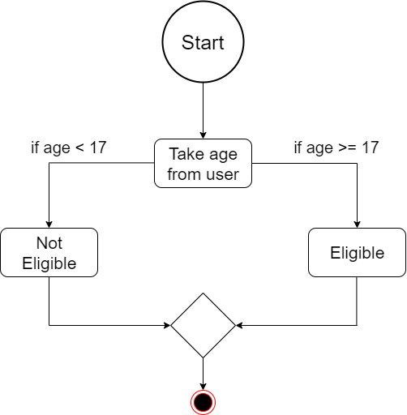
AN ALGORITHM IS A SET OF STEPS TO BE FOLLOWED TO SOLVE A PROBLEM. THIS IS WHAT THE ALGORITHM FOR OUR PROGRAM WOULD LOOK LIKE

Slide 63
THE IF STATEMENT
SO WHAT DOES THIS LOOK LIKE IN OUR CODE?
AGE = INT(INPUT(“PLEASE ENTER YOUR AGE"))
IF AGE >= 17:
PRINT(“YOU ARE ELIGIBLE TO APPLY FOR A DRIVERS LICENCE.")
IF AGE < 17:
PRINT("SORRY, YOU CANNOT DRIVE YET.“)
INPUT: 19
OUTPUT: YOU ARE ELIGIBLE TO APPLY FOR A DRIVERS LICENCE.
INPUT: 13
OUTPUT: SORRY, YOU CANNOT DRIVE YET.

Slide 64
THE IF STATEMENT
WHY ARE THE PRINT() FUNCTIONS INDENTED LIKE THIS??
AGE = INT(INPUT(“PLEASE ENTER YOUR AGE"))
IF AGE >= 17: STATEMENT
PRINT(“YOU ARE ELIGIBLE TO APPLY FOR A DRIVERS LICENCE.") CODE BLOCK
IF AGE < 17: STATEMENT
PRINT("SORRY, YOU CANNOT DRIVE YET.") CODE BLOCK
INPUT: 19
OUTPUT: YOU ARE ELIGIBLE TO APPLY FOR A DRIVERS LICENCE.
NOTICE THE INDENTATION! THIS IS EXTREMELY IMPORTANT IN PYTHON.
IT INDICATES WHAT BLOCK OF CODE BELONGS TO WHAT STATEMENT.

Slide 65
THE IF STATEMENT
SO WHAT IS HAPPENING HERE?
THE PROGRAM WILL RUN AS NORMAL UNTIL IT COMES TO THE IF STATEMENT.
IT WILL EVALUATE IF THE STATEMENT IS TRUE OR FALSE.
IF THE STATEMENT IS TRUE, THE PROGRAM WILL EXECUTE THE INDENTED CODE BLOCK
CONDITIONAL IF STATEMENT
IF AGE < 17:
PRINT(“SORRY, YOU CANNOT DRIVE YET.")
INDENTED CODE BLOCK
THE INDENTED CODE BLOCK WILL EXECUTE ONLY IF THE CONDITIONAL IF STATEMENT EVALUATES TO TRUE. IF THE IF STATEMENT EVALUATES TO FALSE, THE CODE BLOCK WILL BE IGNORED.

Slide 66


Slide 67
THE IF ELSE STATEMENT
THE IF ELSE STATEMENT IS SIMILAR TO THE IF STATEMENT, BUT IT GUARANTEES THAT A CODE BLOCK WILL BE EXECUTED.
IF THE IF STATEMENT EVALUATES TO TRUE, THE IF CODE BLOCK WILL BE EXECUTED.
IF THE IF STATEMENT EVALUATES TO FALSE, THE ELSE CODE BLOCK WILL BE EXECUTED.
age = int(input(“Please enter your age"))
if age >= 17:
print(“You are eligible to apply for a drivers licence.“) else:
print("Sorry, you cannot drive yet.")
User input variable
IF statement
First indented code block
ELSE statement
Second indented code block
Input: 12
Output: Sorry, you cannot drive yet.

Slide 68


Slide 69
THE IF ELSE ELIF STATEMENT
THE IF ELSE ELIF STATEMENT IS SIMILAR TO THE IF ELSE STATEMENT, BUT IT ADDS IN MORE CONDITIONS.
IF THE IF STATEMENT EVALUATES TO TRUE, THE IF CODE BLOCK WILL BE EXECUTED.
IF ONE OF THE ELIF STATEMENTS EVALUATES TO TRUE, THE CODE BLOCK INSIDE THAT ELIF WILL BE EXECUTED.
IF THE IF STATEMENT AND ALL OF THE ELIF STATEMENTS EVALUATE TO FALSE, THE ELSE CODE BLOCK WILL BE EXECUTED.
age = int(input(“Please enter your age"))
if age > 17:
print(“You are eligible to apply for a drivers licence.“)
elif age == 17:
print(“You are exactly the right age.”) else:
print("Sorry, you cannot drive yet.")
User input variable
IF statement
First indented code block
ELIF statement
Second indented code block
ELSE statement
Third indented code block
Input: 17
Output: You are exactly the right age.

Slide 70
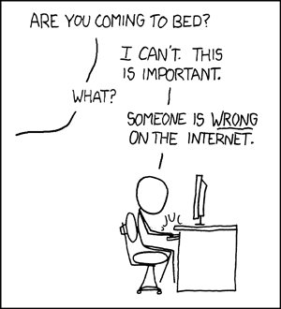
SOME USEFUL INFORMATION
BY INDENTING A LINE IT BECOMES A BLOCK. A BLOCK IS ONE IS ONE OR MORE CONSECUTIVE
LINES INDENTED BY THE SAME AMOUNT.
THE INDENT IS EQUAL TO 4 SPACES OR 1 TAB. CODERS AROUND THE WORLD HAVE ARGUMENTS
ABOUT WHETHER TO USE TABS OR SPACES ALL THE TIME, THE FACT IS THAT IT DOESN’T MATTER.
BLOCKS CAN BE USED, AS WE SAW HERE TODAY, AS PART OF AN IF STATEMENT. THEY’RE
THE STATEMENT OR GROUP OF STATEMENTS THAT GETS EXECUTED IF THE CONDITION IS TRUE.
YOU CAN HAVE AS MANY ELIF STATEMENTS AS YOU REQUIRE. IN OUR EXAMPLE WE ONLY USED ONE, BUT YOU CAN HAVE 2, 3, 4 OR MORE IF YOU NEED.
IN AN IF ELSE ELIF STATEMENT, AS SOON AS ONE STATEMENT IS FOUND TO BE TRUE, IT WILL EXECUTE AND NO OTHER CODE BLOCK WILL BE EXECUTED IN THAT IF ELSE ELIF STATEMENT.

Slide 71
SUMMARY
TODAY YOU LEARNED ABOUT:
EQUALITY OPERATORS: USED TO MAKE COMPARISONS BETWEEN VALUES.
< > == <= >= !=
WE USE == TO CHECK IF ONE VALUE IS EQUAL TO ANOTHER VALUE.
REMEMBER WE USE = TO ASSIGN VALUES TO VARIABLES.
THE IF STATEMENT
IF THE IF STATEMENT EVALUATES TO TRUE, THE INDENTED CODE BLOCK WILL EXECUTE.
IF THE IF STATEMENT EVALUATES TO FALSE, THE INDENTED CODE BLOCK WILL BE IGNORED.
THE IF ELSE STATEMENT
GUARANTEES THAT EITHER THE IF OR THE ELSE CODE BLOCK WILL BE EXECUTED
THE IF ELSE ELIF
LIKE THE ELSE IF STATEMENT BUT ADDS IN MORE CONDITIONS.
IN AN IF ELSE ELIF STATEMENT, AS SOON AS ONE STATEMENT IS FOUND TO BE TRUE, IT WILL EXECUTE, AND NO OTHER CODE BLOCK WILL BE EXECUTED IN THAT IF ELSE ELIF STATEMENT.

Slide 72
LESSON 06
ITERATION

Slide 73
LESSON 5 RECAP
IN THE FIFTH LESSON WE LEARNED ABOUT:
EQUALITY OPERATORS: USED TO MAKE COMPARISONS BETWEEN VALUES.
< > == <= >= !=
WE USE == TO CHECK IF ONE VALUE IS EQUAL TO ANOTHER VALUE.
REMEMBER WE USE = TO ASSIGN VALUES TO VARIABLES.
THE IF STATEMENT
IF THE IF STATEMENT EVALUATES TO TRUE, THE INDENTED CODE BLOCK WILL EXECUTE.
IF THE IF STATEMENT EVALUATES TO FALSE, THE INDENTED CODE BLOCK WILL BE IGNORED.
THE IF ELSE STATEMENT
GUARANTEES THAT EITHER THE IF OR THE ELSE CODE BLOCK WILL BE EXECUTED.
THE IF ELSE ELIF
LIKE THE ELSE IF STATEMENT BUT ADDS IN MORE CONDITIONS.
IN AN IF ELSE ELIF STATEMENT, AS SOON AS ONE STATEMENT IS FOUND TO BE TRUE, IT WILL EXECUTE, AND NO OTHER CODE BLOCK WILL BE EXECUTED IN THAT IF ELSE ELIF STATEMENT.

Slide 74

WHAT IS ITERATION?
ITERATION IS THE FORM OF PROGRAM CONTROL THAT ALLOWS US TO INSTRUCT THE COMPUTER TO CARRY OUT A TASK OVER AND OVER AGAIN BY REPEATING A SECTION OF CODE, ALSO CALLED REPETITION, E.G. TAKING IN DATA FROM THE USER RELATING TO MULTIPLE EMPLOYEES, STUDENTS, REPEATED CALCULATIONS ETC.
THE PROGRAM STRUCTURE THAT IS USED TO CONTROL THIS REPETITION IS CALLED A LOOP.
THERE ARE TWO TYPES OF LOOPS IN PYTHON
WHILE
FOR

Slide 75
The while loop

Slide 76
THE WHILE LOOP
THE WHILE STATEMENT CONTINUALLY EXECUTES A BLOCK OF STATEMENTS WHILE A PARTICULAR CONDITION IS TRUE, SIMILAR STRUCTURE TO AN IF STATEMENT.
THE WHILE STATEMENT EVALUATES THE CONDITION, WHICH MUST RETURN A BOOLEAN VALUE, EITHER TRUE OR FALSE.
counter = 0
while counter < 10:
print(counter)
counter += 1
Indentation is really important
Indented code is run inside of the loop

Slide 77


THE WHILE LOOP
Lets build a program which prints and counts from a start number to an end number.
So, what inputs will our program need?
Inputs: startNumber, endNumber
So we want to print all the numbers between the startNumber and the endNumber and add all the numbers up too.

Slide 78
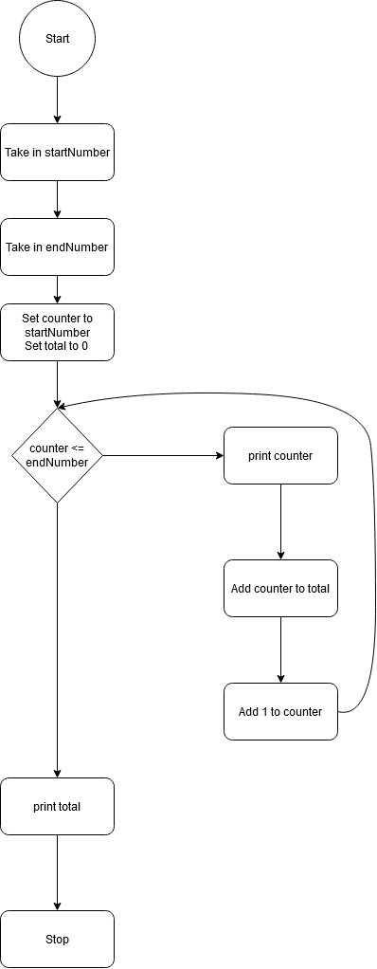
AN ALGORITHM IS A SET OF STEPS TO BE FOLLOWED TO SOLVE A PROBLEM. THIS IS WHAT THE ALGORITHM FOR OUR PROGRAM WOULD LOOK LIKE

Slide 79

THE WHILE LOOP
startNumber = int(input("Please enter a start value: "))
endNumber = int(input("Please enter an end value: "))
total = 0
for i in range(startNumber, endNumber+1):
print("The value of i is:",i)
total += i
print("Total is :",total)
---
Input:
Please enter a start value: 1
Please enter an end value: 10
Output:
The value of i is: 1
The value of i is: 2
..
The value of i is: 10
Total is : 55

Slide 80
THE WHILE LOOP
INDENTATION
WHILE COUNTER <= ENDNUMBER:
PRINT("THE COUNTER VALUE IS :",COUNTER)
TOTAL += COUNTER
COUNTER +=1
NOTICE THE INDENTATION! THIS IS EXTREMELY IMPORTANT IN PYTHON.
IT INDICATES WHAT BLOCK OF CODE BELONGS TO WHAT STATEMENT.

Slide 81
THE WHILE LOOP RUNNING
STARTNUMBER = INT(INPUT("PLEASE ENTER A START VALUE: "))
ENDNUMBER = INT(INPUT("PLEASE ENTER AN END VALUE: "))
COUNTER = STARTNUMBER
TOTAL = 0
WHILE COUNTER <= ENDNUMBER:
PRINT("THE COUNTER VALUE IS :",COUNTER)
TOTAL += COUNTER
COUNTER +=1
PRINT("TOTAL IS :",TOTAL)
INPUT:
STARTNUMBER = 1
ENDNUMBER = 5
counter
total
1
1
2
3
3
6
4
10
5
15
The counter value is : 1
The counter value is : 2
The counter value is : 3
The counter value is : 4
The counter value is : 5
Total is : 15

Slide 82
THE WHILE LOOP
LETS BUILD ANOTHER PROGRAM WHICH READS IN CHARACTERS FROM THE KEYBOARD. THE PROGRAM SHOULD STOP WHEN THE LETTER ‘Z’ IS ENTERED.
SO, WHAT INPUTS WILL OUR PROGRAM NEED?
Inputs: inputLetter
We want to end when the letter ‘z’ is entered.

Slide 83
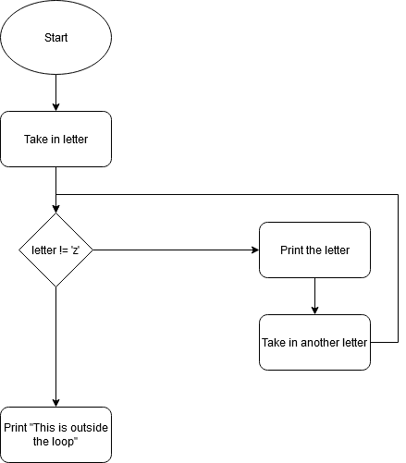
AN ALGORITHM IS A SET OF STEPS TO BE FOLLOWED TO SOLVE A PROBLEM. THIS IS WHAT THE ALGORITHM FOR OUR PROGRAM WOULD LOOK LIKE

Slide 84
THE WHILE LOOP
SO WHAT DOES THIS LOOK LIKE IN OUR CODE?
INPUTLETTER = INPUT("PLEASE ENTER A LETTER: ")
WHILE INPUTLETTER != ‘Z’:
PRINT(“THE ENTERED LETTER IS :",INPUTLETTER)
INPUTLETTER = INPUT("PLEASE ENTER ANOTHER LETTER: ")
PRINT(“THIS IS OUTSIDE THE LOOP”)
PLEASE ENTER A LETTER: A
PLEASE ENTER A LETTER: B
PLEASE ENTER A LETTER: C
PLEASE ENTER A LETTER: Z
THIS IS OUTSIDE THE LOOP

Slide 85
The
for
loop

Slide 86
THE FOR LOOP
SIMILAR TO THE WHILE THE LOOP, THE FOR LOOP WILL CONSIST OF THE FOR KEYWORD. THE FOR LOOP WORKS BEST FOR COUNTING.
WITH A FOR LOOP WE USE THE RANGE FUNCTION TO DEFINE A RANGE TO COUNT BETWEEN.
for i in range(1,6):
print(i)
Indentation is really important
Indented code is run inside of the loop

Slide 87
THE FOR LOOP
LETS BUILD A PROGRAM WHICH PRINTS AND COUNTS FROM A START NUMBER TO AN END NUMBER.
SO, WHAT INPUTS WILL OUR PROGRAM NEED?
Inputs: startNumber, endNumber
So we want to print all the numbers between the startNumber and the endNumber and add all the numbers up too.

Slide 88
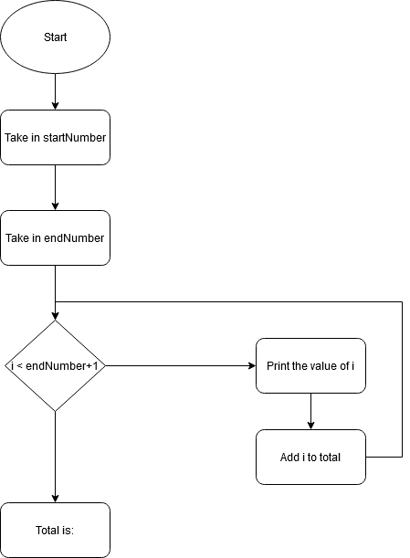
AN ALGORITHM IS A SET OF STEPS TO BE FOLLOWED TO SOLVE A PROBLEM. THIS IS WHAT THE ALGORITHM FOR OUR PROGRAM WOULD LOOK LIKE

Slide 89
THE FOR LOOP
SO WHAT DOES THIS LOOK LIKE IN OUR CODE?
STARTNUMBER = INT(INPUT("PLEASE ENTER A START VALUE: "))
ENDNUMBER = INT(INPUT("PLEASE ENTER AN END VALUE: "))
TOTAL = 0
FOR I IN RANGE(STARTNUMBER, ENDNUMBER+1):
PRINT("THE VALUE OF I IS:",I)
TOTAL += I
PRINT("TOTAL IS :",TOTAL)
INPUT:
PLEASE ENTER A START VALUE: 1
PLEASE ENTER AN END VALUE: 10
OUTPUT:
THE VALUE OF I IS: 1
THE VALUE OF I IS: 2
..
THE VALUE OF I IS: 10
TOTAL IS : 55

Slide 90
THE FOR LOOP RUNNING
STARTNUMBER = INT(INPUT("PLEASE ENTER A START VALUE: "))
ENDNUMBER = INT(INPUT("PLEASE ENTER AN END VALUE: "))
TOTAL = 0
FOR I IN RANGE(STARTNUMBER, ENDNUMBER+1):
PRINT("THE VALUE OF I IS:",I)
TOTAL += I
PRINT("TOTAL IS :",TOTAL)
INPUT:
STARTNUMBER = 1
ENDNUMBER = 5
i
total
1
1
2
3
3
6
4
10
5
15
The value of i is: 1
The value of i is : 2
The value of i is : 3
The value of i is : 4
The value of i is : 5
Total is : 15

Slide 91
THE FOR LOOP
LETS BUILD A PROGRAM WHICH PRINTS EACH CHARACTER IN A NAME
SO, WHAT INPUTS WILL OUR PROGRAM NEED?
Inputs: inputName
So we want to print all the characters in a string.

Slide 92
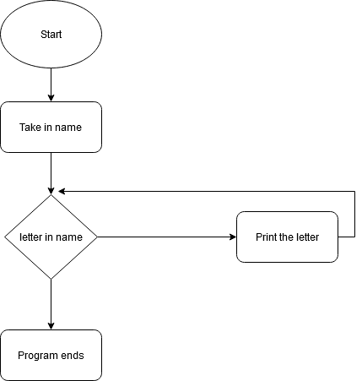
AN ALGORITHM IS A SET OF STEPS TO BE FOLLOWED TO SOLVE A PROBLEM. THIS IS WHAT THE ALGORITHM FOR OUR PROGRAM WOULD LOOK LIKE

Slide 93
THE FOR LOOP
SO WHAT DOES THIS LOOK LIKE IN OUR CODE?
INPUTNAME = INPUT("PLEASE ENTER A NAME: ")
FOR LETTER IN INPUTNAME:
PRINT("THE LETTER IS:",LETTER)
INPUT:
PLEASE ENTER A NAME: JOHN
OUTPUT:
THE LETTER IS: J
THE LETTER IS: O
THE LETTER IS: H
THE LETTER IS: N

Slide 94
SUMMARY
TODAY YOU LEARNED ABOUT:
WHILE LOOP.
BETTER SUITED FOR UNKNOWN ENDINGS LIKE WHEN ‘Z’ IS ENTERED.
LOOP ENDS WHEN THE CONDITION IS MET.
FOR LOOP.
BEST FOR RUNNING BETWEEN TWO PARTICULAR NUMBERS OR A RANGE OR A SET NUMBER OF TIMES.
BEST FOR PRINTING LETTERS FROM A STRING.

Slide 95
LESSON 07
LISTS

Slide 96
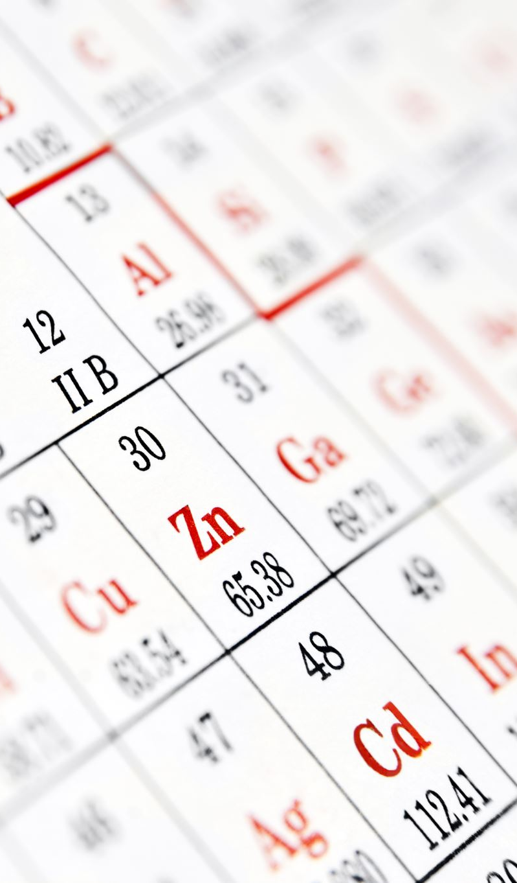
LESSON 6 RECAP
IN THE SIXTH LESSON WE LEARNED ABOUT:
WHILE LOOP.
BETTER SUITED FOR UNKNOWN ENDINGS LIKE WHEN ‘Z’ IS ENTERED.
LOOP ENDS WHEN THE CONDITION IS MET.
FOR LOOP.
BEST FOR RUNNING BETWEEN TWO PARTICULAR NUMBERS OR A RANGE OR A SET NUMBER OF TIMES.
BEST FOR PRINTING LETTERS FROM A STRING.

Slide 97

WHAT IS A LIST?
A LIST IS A COLLECTION OF OBJECTS WHICH IS STORED IN ONE VARIABLE.
LISTS CAN CONTAIN ANY SORT OF OBJECT:
NUMBERS
STRINGS
EVEN OTHER LISTS
ANOTHER NAME FOR A LIST IS AN ARRAY.

Slide 98
A list

Slide 99
A LIST
A LIST BEGINS WITH AN OPENING SQUARE BRACKET AND ENDS WITH A CLOSING SQUARE BRACKET. THE VALUES INSIDE A LIST ARE SEPARATED BY A COMMA (,)
THE FOLLOWING ARE EXAMPLES OF LISTS:
numbers = [1,2,3,4,5]
letters = [‘a’,‘e’,‘i’,‘o’,‘u’]
names = [‘John’, ‘Jacob’, ‘Paul’]
pairs = [[1,2],[3,4],[5,6]]

Slide 100
A LIST
LIKE STRINGS, LISTS CAN BE INDEXED AND INDIVIDUAL ITEMS CAN BE PRINTED OUT.
LETTERS = [‘A’,‘E’,‘I’,‘O’,‘U’]
Index | Value | Item
letters[0] | ‘a’ | 1
letters[1] | ‘e’ | 2
letters[2] | ‘i’ | 3
letters[3] | ‘o’ | 4
letters[4] | ‘u’ | 5

Slide 101
A LIST
LIKE STRINGS, LISTS CAN BE INDEXED AND INDIVIDUAL ITEMS CAN BE PRINTED OUT.
PAIRS = [[1,2],[3,4],[5,6]]
Index | Value | Item
pairs[0][0] | 1 | 1,1
pairs[0][1] | 2 | 1,2
pairs[1][0] | 3 | 2,1
pairs[1][1] | 4 | 2,2
pairs[2][0] | 5 | 3,1
pairs[2][1] | 6 | 3,2

Slide 102
A LIST
LI = [1, 2, 3, 4, 5]
LI.APPEND(‘A’)
PRINT(LI)
[1, 2, 3, 4, 5, ‘A’]
LI.INSERT(2, ‘I’)
PRINT(LI)
[1, 2, ‘I’, 3, 4, 5, ‘A’]

Slide 103
A LIST
LI = [‘A’, ‘B’, ‘C’, ‘B’]
PRINT(LI.INDEX(‘B’)) # INDEX OF FIRST OCCURRENCE
1
PRINT(LI.COUNT(‘B’)) # NUMBER OF OCCURRENCES
2
LI.REMOVE(‘B’) # REMOVE FIRST OCCURRENCE
PRINT(LI)
[‘A’, ‘C’, ‘B’]

Slide 104
A LIST
LI = [5, 2, 6, 8]
LI.REVERSE() # REVERSE THE LIST *IN PLACE*
PRINT(LI)
[8, 6, 2, 5]
LI.SORT() # SORT THE LIST *IN PLACE*
PRINT(LI)
[2, 5, 6, 8]

Slide 105
PRINTING THE ITEMS OF A LIST
SO WHAT DOES THIS LOOK LIKE IN OUR CODE?
NUMBERS = [1,2,3,4,5]
FOR NUMBER IN NUMBERS:
PRINT(“THE NUMBER IS:”, NUMBER)
OUTPUT:
THE NUMBER IS: 1
THE NUMBER IS: 2
THE NUMBER IS: 3
THE NUMBER IS: 4
THE NUMBER IS: 5

Slide 106
ADDING NUMBERS TO A LIST
SO WHAT DOES THIS LOOK LIKE IN OUR CODE?
NUMBERS = []
FOR I IN RANGE(1,6):
NUMBER = INT(INPUT(“PLEASE ENTER A NUMBER:”))
NUMBERS.APPEND(NUMBER)
PRINT(NUMBERS)
INPUT:
PLEASE ENTER A NUMBER: 23
PLEASE ENTER A NUMBER: 14
PLEASE ENTER A NUMBER: -11
OUTPUT:
[23, 14, -11]

Slide 107
SUMMING NUMBERS IN A LIST
SO WHAT DOES THIS LOOK LIKE IN OUR CODE?
NUMBERS = [1,2,3,4,5]
TOTAL = 0
FOR NUMBER IN NUMBERS:
TOTAL += NUMBER
PRINT(“THE TOTAL IS:”,TOTAL)
OUTPUT:
THE TOTAL IS 15

Slide 108
SUMMARY
TODAY YOU LEARNED ABOUT:
LISTS.
SIMILAR TO STRINGS
CAN CONTAIN MULTIPLE TYPES OF DATA INCLUDING OTHER LISTS.
LIST FUNCTIONS SUCH AS :
APPEND
INSERT
INDEX
COUNT
REMOVE
REVERSE
SORT

Slide 109
LESSON 08
TURTLE GRAPHICS

